Slide 1
Lesson 11: Solving Mechanical System Dynamics Using Laplace Transforms
ET 438a Automatic Control Systems Technology

Slide 2
Learning Objectives
After this presentation you will be able to:
Draw a free body diagram of a translational mechanical system,
Write a differential equation that describes the position of a mechanical system as it varies in time.
Use Laplace transforms to convert differential equations into algebraic equations.
Take the Inverse Laplace transform and find the time response of a mechanical system.
Examine the impact of increased and decreased damping on a mechanical system.

Slide 3
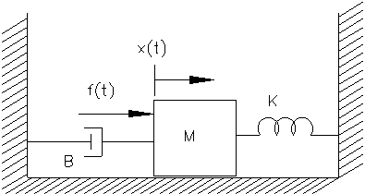
Using Laplace Transforms to Solve Mechanical Systems
Example 11-1: Write the differential equation for the system shown with respect to position and solve it using Laplace transform methods. Assume f(t) = 50∙u_{s}(t) N, M= 1 Kg, K=2.5 N/m and B=0.5 N-s/m. The mass slides on a frictionless surface. x(0)=0.
+
Draw a free body diagram and label the forces
f(t)
f_{I}(t)
f (t)
- f_{I}(t)
- f_{B}(t)
- f_{K}(t) = 0
M= 1 Kg
f_{B}(t)
f(t)=f_{I}(t)+f_{B}(t)+f_{K}(t)
f_{K}(t)

Slide 4
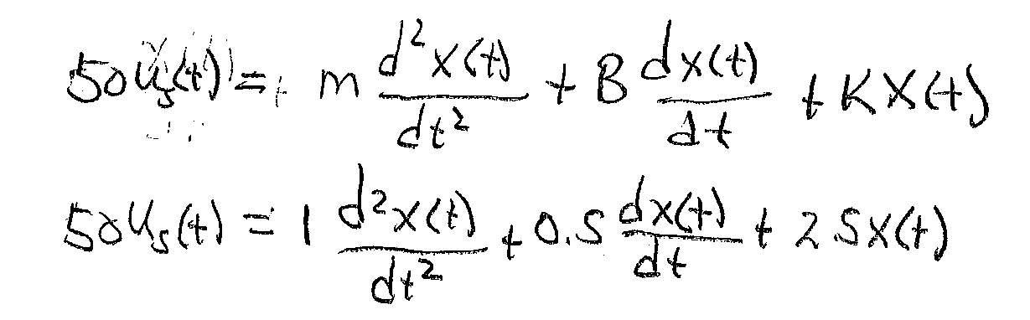
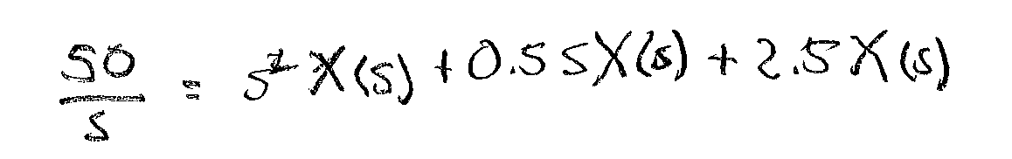
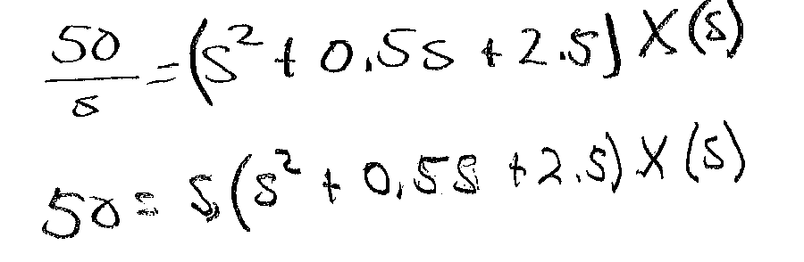
Laplace Solution to Mechanical Systems (1)
Solve for X(s)

Slide 5
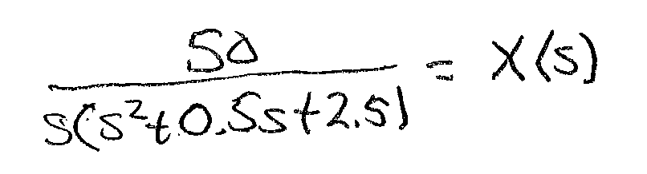
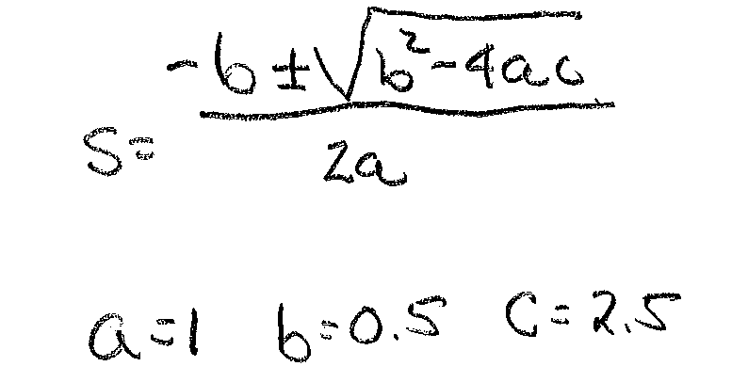
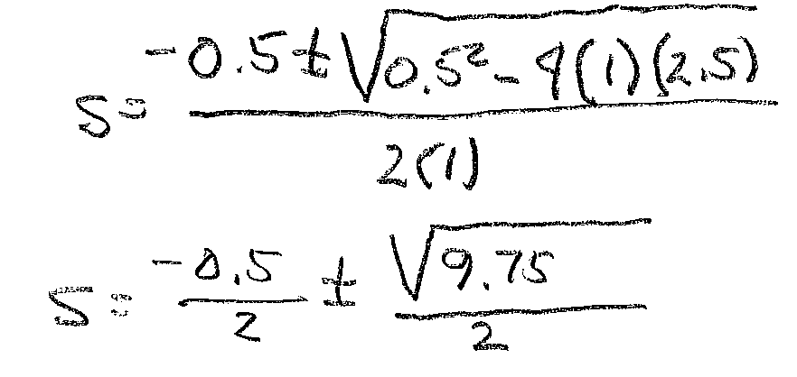
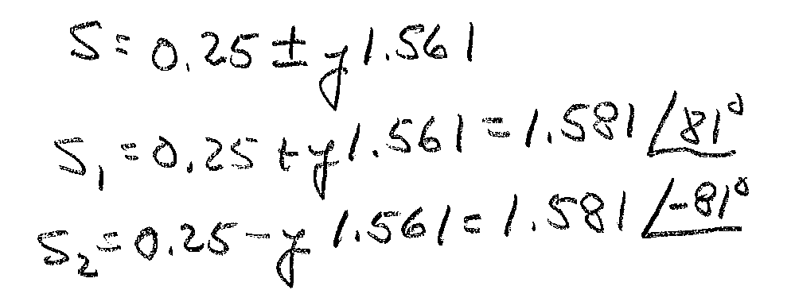

Laplace Solution to Mechanical Systems (2)
Solve using inverse Laplace transform and partial fractions expansion
Use Quadratic formula to find factors in denominator

Slide 6
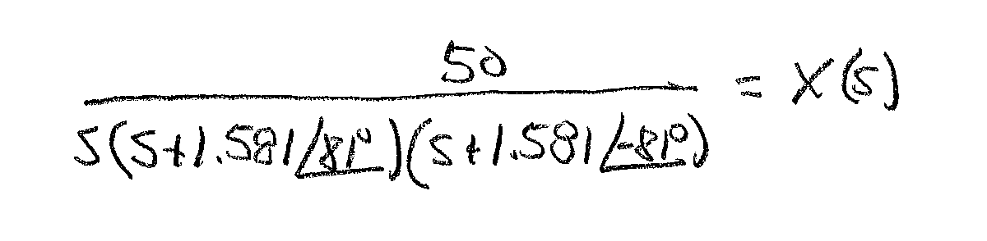
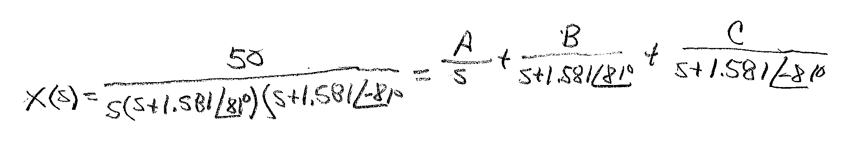
Laplace Solution to Mechanical Systems (3)
Factored form
s₁
s₂
Partial Fractions Expansion- Find A

Slide 7
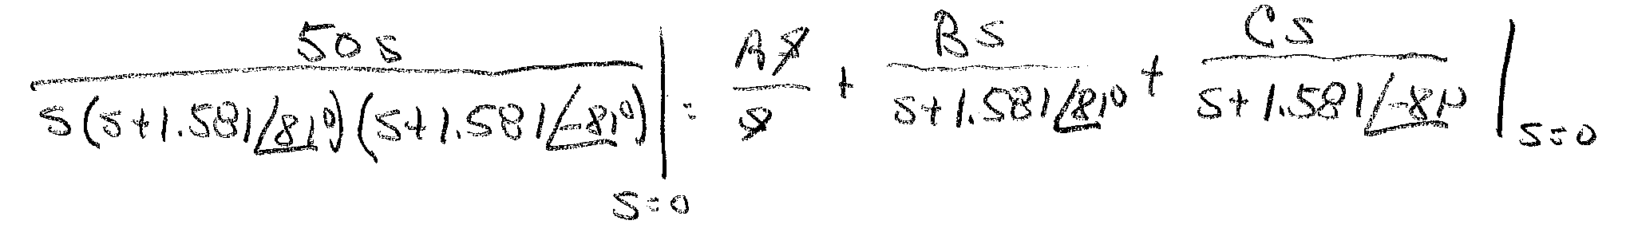
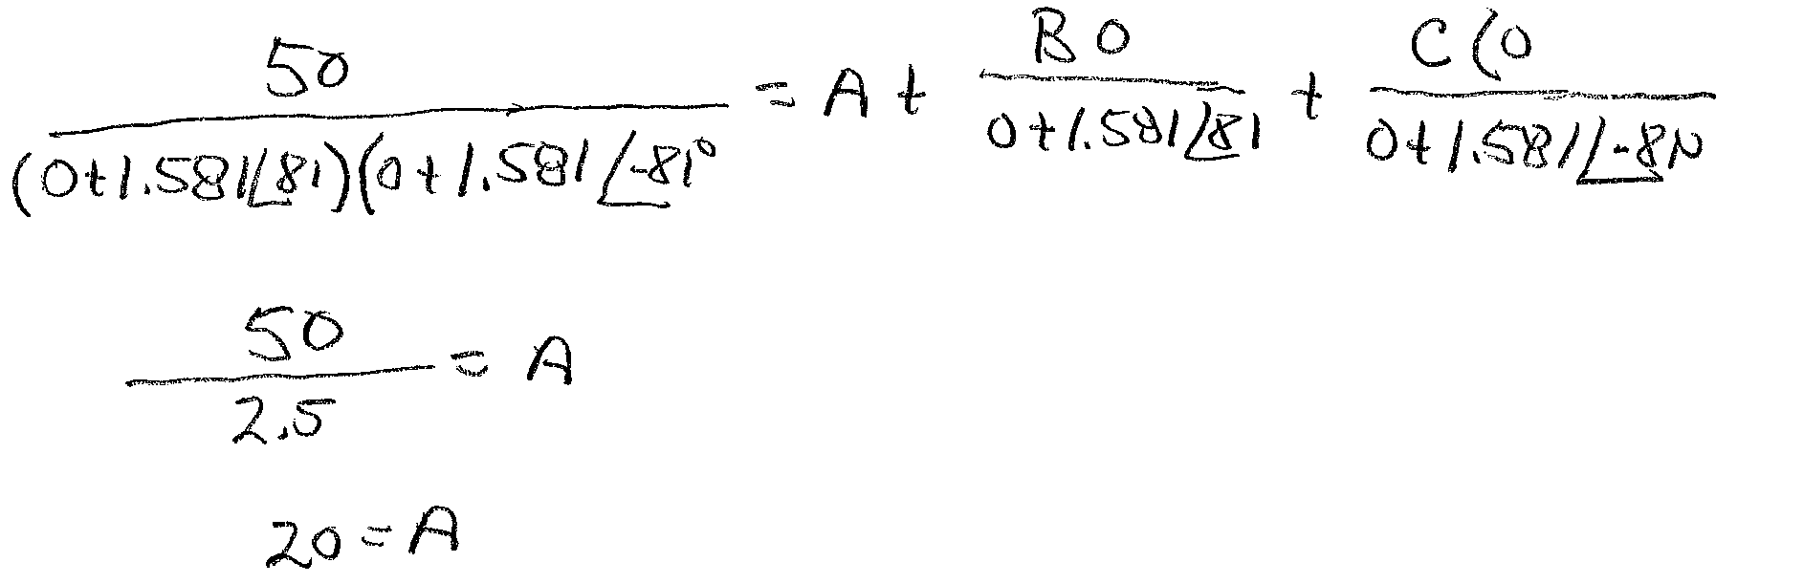
Laplace Solution to Mechanical Systems (4)

Slide 8
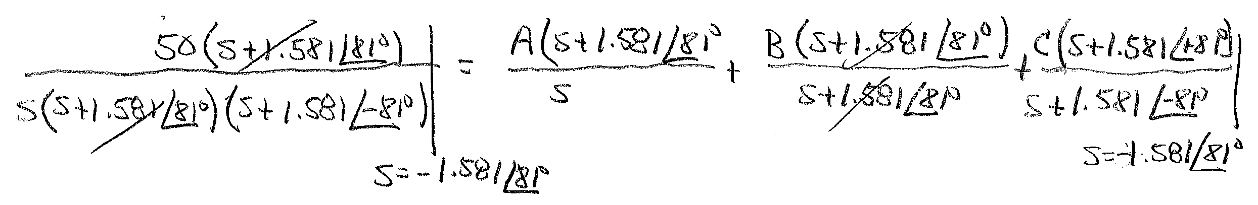
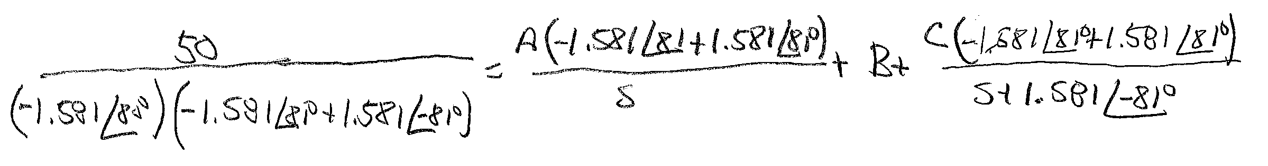
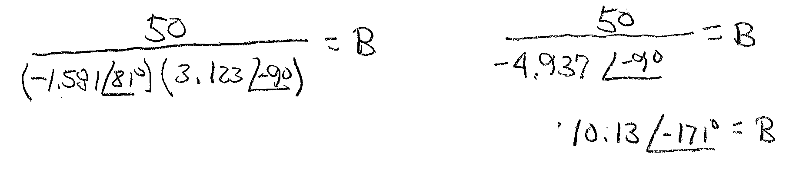
Laplace Solution to Mechanical Systems (5)
Find B

Slide 9
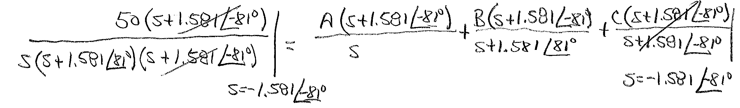
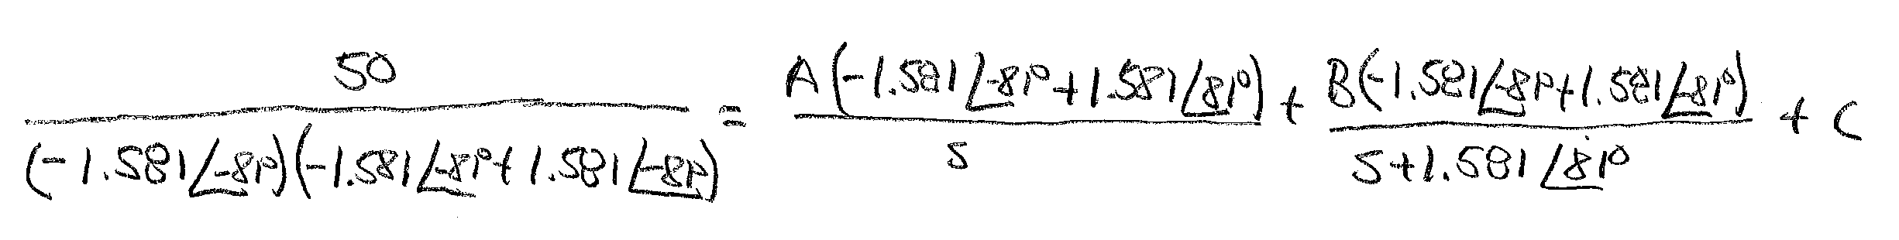
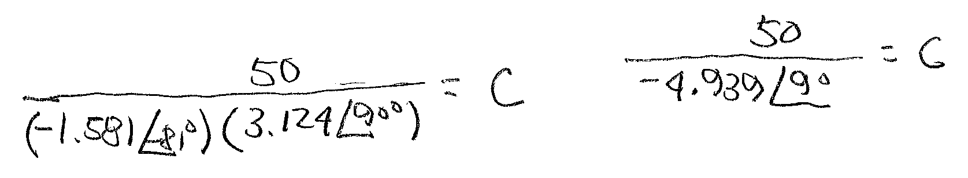
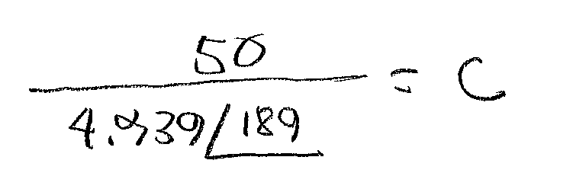
Laplace Solution to Mechanical Systems (6)
Find C
0
0

Slide 10
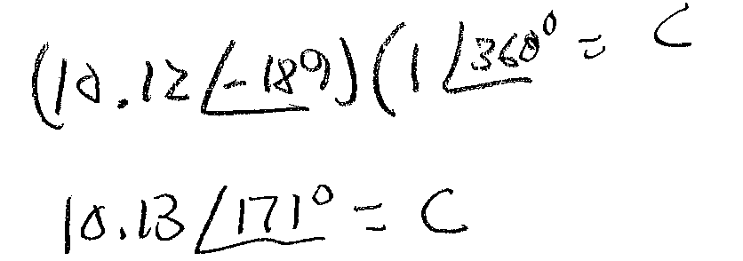
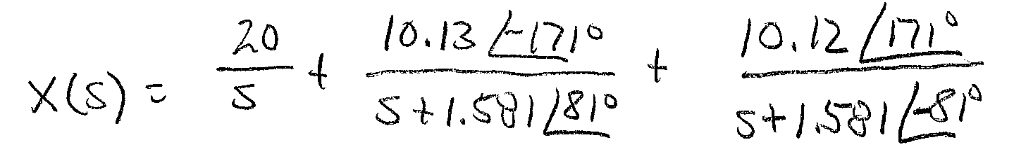
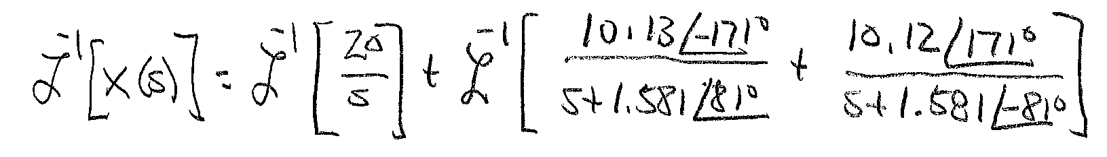
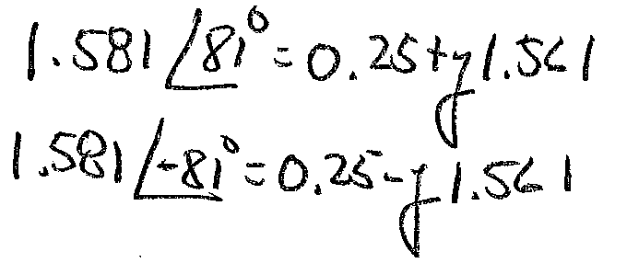
Laplace Solution to Mechanical Systems (7)
Reverse angle
rotation
Expanded Laplace relationship
Remember

Slide 11
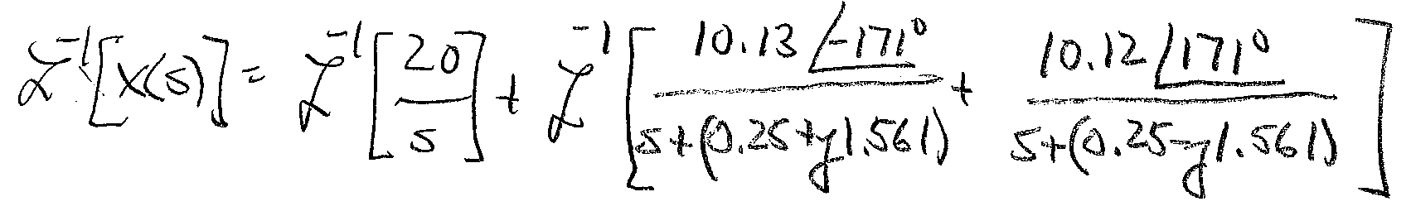
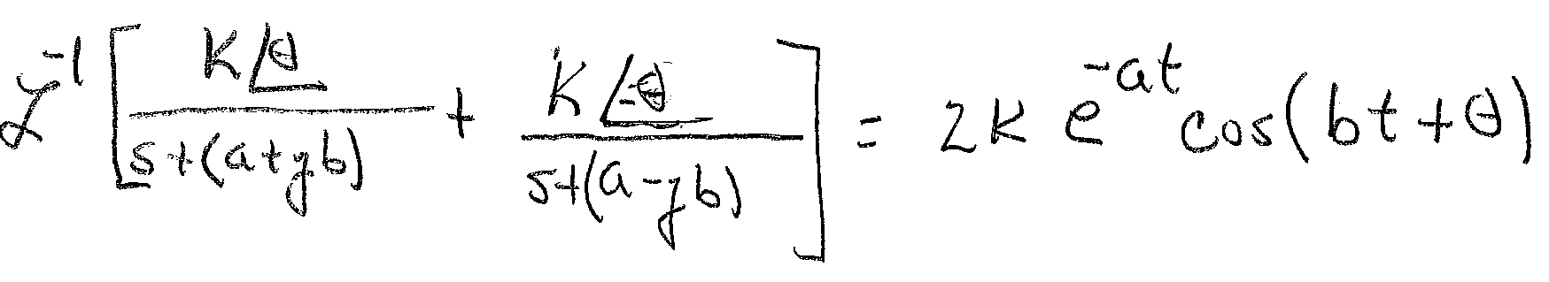
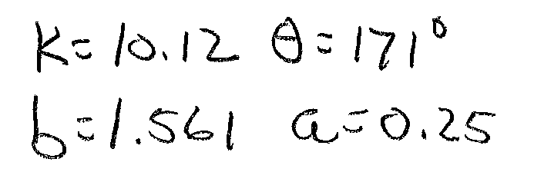
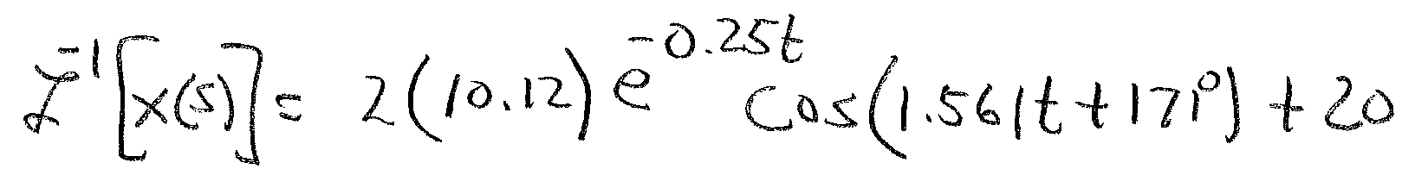
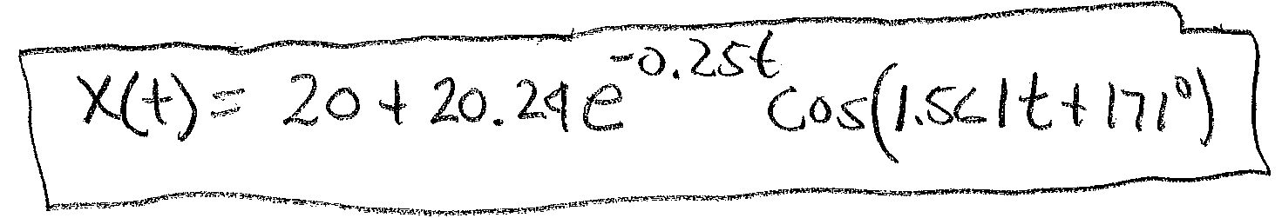
Laplace Solution to Mechanical Systems (8)
From Laplace
table
Where
Ans

Slide 12
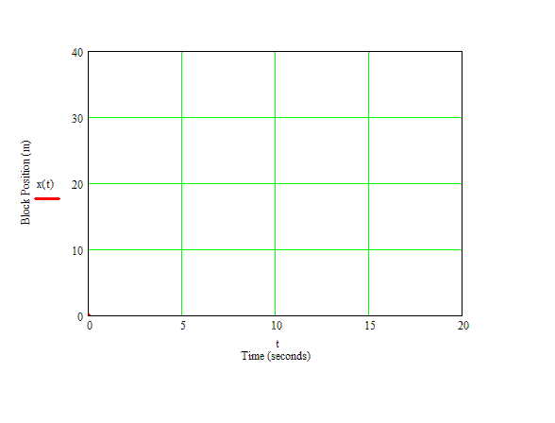
Time Plot of System Position
Damping of system is B=0.5

Slide 13
Effects of Increased Damping
Large damping
value reduces
oscillations and overshoot
but slows response

Slide 14
End Lesson 11: Solving Mechanical System Dynamics Using Laplace Transforms
ET 438a Automatic Control Systems Technology

